Slide 1
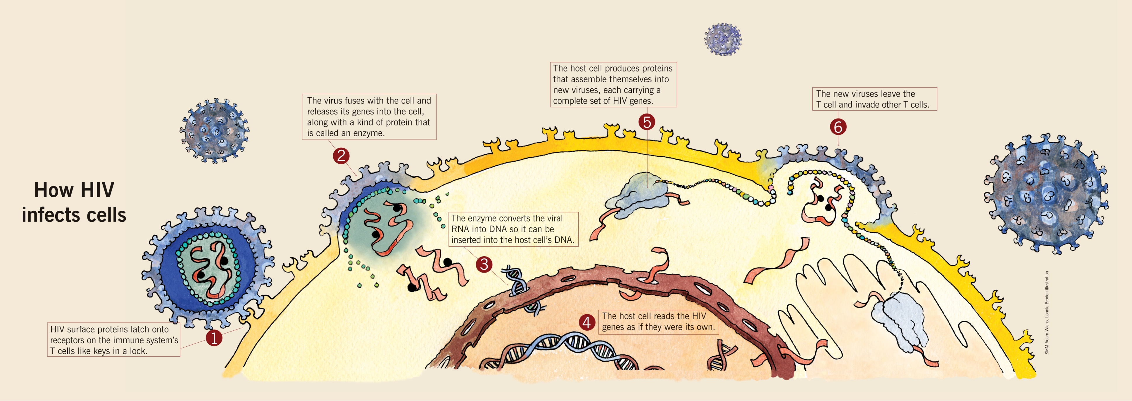

Students’ and Teachers’ Beliefs About the Microbiological Structure and Activity of Viruses and Vaccines
Benjamin D. Jee¹ (bjee@holycross.edu), David H. Uttal², Amy Spiegel³, and Judy Diamond⁴
¹College of the Holy Cross, ²Northwestern University, ³University of Nebraska-Lincoln, ⁴University of Nebraska State Museum
Introduction
Viral diseases create health concerns around the globe
Ignorance and misunderstanding undermine viral control efforts^{1,2}
Beliefs about the transmission of illness vary within and between cultures^{2,3}
What do people believe about the micro-scale processes of infection and vaccination?
Results: Quantitative Analyses
Mental models of vaccines and vaccination
Table 1. Mean number of structures, behaviors, and functions by experience level
Expert model (4/13 students and 18/18 teachers)
 | Structures | Behaviors | Functions | Total
Students | 2.69 | 2.92 | 1.92 | 2.51
Teachers | 3.56 | 3.22 | 3.33 | 3.37
Experts | 5.86 | 5.57 | 4.43 | 5.29
Total | 3.68 | 3.55 | 3.05
Vaccine
contains
Virulence
factor of virus
Immune system
protects from
Future virus infection
stimulates
eliminates
Experts discussed more key topics in total than students and teachers
Participants described structures most often, followed by behaviors and functions
Virologist on vaccines: “A vaccine is really an artificial means of stimulating the immune system to protect you against some infectious agent…You find out what part of the viral particle could be part of the virulence factor of the virus and you try to find a way to stimulate the immune system to knock that out.”
Teacher on vaccines: “A vaccine…is a small amount of the virus that they are putting into your body to hope that your body will take that and make antibodies, if I’m thinking correctly, against that disease. So that if you come in contact with [the virus] you will not get it.” (Teacher)
Table 2. Proportion of participants discussing topics at each level of description
Topic |  | Students |  |  |  | Teachers |  |  |  | Experts
 |  | S | B | F |  | S | B | F |  | S | B | F
Virus appearance |  | .23 | .15 | .08 |  | .39 | .28 | .28 |  | 1.0 | .57 | .57
Host appearance |  | .15 | .08 | .08 |  | .17 | .00 | .00 |  | .43 | .29 | .00
Virus contents |  | .85 | .38 | .31 |  | .83 | .72 | .67 |  | 1.0 | 1.0 | 1.0
Host contents |  | .46 | .08 | .00 |  | .61 | .22 | .17 |  | 1.0 | .29 | .14
Replicated virus |  | .00 | .31 | .00 |  | .06 | .56 | .44 |  | .57 | .86 | .43
Immune resp. |  | .00 | .62 | .31 |  | .00 | .22 | .39 |  | .00 | .86 | .43
Immune cell |  | .54 | .46 | .23 |  | .50 | .29 | .44 |  | .86 | .71 | .86
Vaccine |  | .46 | .85 | .92 |  | 1.0 | .83 | .94 |  | 1.0 | 1.0 | 1.0
Common naïve model (7/13 students and 0 teachers )
Fig. 1. How HIV infects cells. Image courtesy of the University of Nebraska State Museum for Explore Evolution funded by the National Science Foundation.
Vaccine
attacks
Virus
is an
contains
is inside
Objectives
Compare beliefs about the microbiology of viruses across three levels of science experience: public school students, public school teachers, and professional virologists
Capture the structure of students’ and teachers’ intuitive mental models
Anti-virus
More powerful
cells than virus
Body
 | > 33% of the group discussed this topic
Student on vaccines: “A vaccine...is like an anti-version of the virus…a vaccine works the same way viruses attack our cells…I think the chemicals or whatever they inject has cells to it…and those are more powerful than the virus itself and it attacks the virus in the body.”
All groups discussed virus contents, immune cell and vaccines at multiple levels of description
Experts discussed experts described almost every topic at multiple levels of description
Method
Participants
13 ninth grade public school students*, 14-15 yrs old
18 public school teachers (primarily science instructors)*
7 virology experts
* From a large, urban school district in the Midwest
Discussion
Results: Qualitative Analyses
Teachers’ beliefs were more detailed than students’, and more likely to align with the experts’ explanations
In some cases, teachers and students had entirely different mental models for virus replication and vaccination
Understanding the mental models that students and teachers bring into the classroom provides a crucial first step toward confronting and correcting misconceptions that hamper scientific understanding
Educational interventions must attempt to replace or refine preexisting beliefs to support conceptual change toward a deeper scientific understanding⁵
Mental models of the contents of the virus: virus replication
Expert model (4/13 students and 11/18 teachers)
Materials & Procedure
All participants completed a semi-structured (approx 60 min.) interview about viruses, including probes such as:
  What is a virus?...Does a virus contain anything?
  How do viruses infect living things?
  How does the body respond to infection?
  What is a vaccine?...How does a vaccine work?
Virus
Human cell
contains
may contain
enters
contains
Virus components (outer protein, etc.)
RNA
DNA
incorporated into
Nucleic acid/DNA
produces
References
Au, T. K., Chan, C. K., Chan, T. K., Cheung, M. K., Ho, J. Y., & Ip, G. W. (2008). Folkbiology meets microbiology: A study of conceptual and behavioral change. Cognitive Psychology, 57, 1-19.
Sigelman, C. K. (2012). Age and Ethnic Differences in Cold Weather and Contagion Theories of Colds and Flu. Health Education & Behavior, 39(1), 67-76.
Legare, C. & Gelman, S. (2008). Bewitchment, biology, or both: The co-existence of natural and supernatural explanatory frameworks across development. Cognitive Science, 32, 607-642.
Hmelo-Silver, C. E., & Pfeffer, M. G. (2004). Comparing expert and novice understanding of a complex system from the perspective of structures, behaviors, and functions. Cognitive Science, 28, 127-138.
Singer, S. R., Nielsen, N. R., & Schweingruber, H. A. (Eds.). (2012). Discipline-Based Education Research: Understanding and Improving Learning in Undergraduate Science and Engineering. National Academies Press.
Virologist on replication: “A virus has RNA on the inside and some have DNA…When [the virus nucleic acid] gets into the cell it incorporates itself into the nucleic acid of the human cell. So it’s using the human cell and it’s using its code to tell that cell to make [the virus] coat, outer protein and everything else.”
The teacher and student responses were often less specific, but involved the same mechanism of replication: taking over the host cell’s DNA
Predictions
Participants with greater science experience will have more extensive knowledge of the structure, behavior, and function of microbiological entities⁴
Participants will express qualitatively different mental models of microbiological processes
Non-experts will endorse scientifically inaccurate models
Common naïve model (6/13 students and 3/18 teachers)
Acknowledgments
This research was supported by the Omaha Schools Foundation and World of Viruses project. World of Viruses is funded by the National Center for Research Resources at the National Institutes of Health through the Science Education Partnership Award (SEPA) Grant No. R25 RR024267-01 (2007- 2012). Its content is solely the responsibility of the authors and does not necessarily represent the official views of NCRR or NIH. We thank Carolyn Crouch, Kristin Watkins, and LaShawnda Lindsey-Dennis for assistance with data collection and coding.
Interview coding
Transcribed interviews were coded using a scheme created by two primary researchers and a virologist (Cohen’s Kappa = .88)
8 key topics were identified, each mentioned by > 20% of respondents
Coded presence of structural, behavioral and functional descriptions⁴
Virus
contains
splits, produces
Daughter cells
(clones of virus)
DNA
Teacher on replication: “Viruses reproduce by splitting…the [virus’] DNA lines up, splits and so there’s two what they call daughter cells and they’re identical cells. So that’s how they reproduce. They just kind of make clones of themselves and copies.”

